Slide 1

Public-Private Engagement and Global Weather Enterprise
ECCAS Hydromet Forum
14-16 November 2018
Libreville, Gabon
Office of Development Partnerships
Cabinet and External Relations Department
dpo@wmo.int
Notes:
L’entreprise météorologique mondiale n’a pas une connotation commerciale, c’est plutôt l’environnement

Slide 2
Global Weather Enterprise (GWE) – definition
The “weather enterprise” is a description of the multitude of systems and entities participating in the production and provision of meteorological, climatological, hydrological, marine and related environmental information and services.
For brevity, the name only refers to “weather”; however, the enterprise encompasses all business areas of WMO, including weather, climate and water.
Important! GWE is still just a ‘notion’ – there is no specific governance or organizational level of the GWE.
Notes:
Entreprise météorologique mondiale
Partenariats publics-privés

Slide 3
GWE – definition
The weather enterprise includes three main sectors:
  Public-sector entities (NMHSs and other governmental agencies)
  Private-sector entities (such as equipment manufacturers, data and service-provider companies, private media companies, etc…)
  Academia: Universities, Research Institutes
Other “players” include:
  Civil society (community-based entities, NGOs, national meteorological societies, scientific associations, etc…)
  Users
The weather enterprise has global, regional, national and local dimensions.

Slide 4
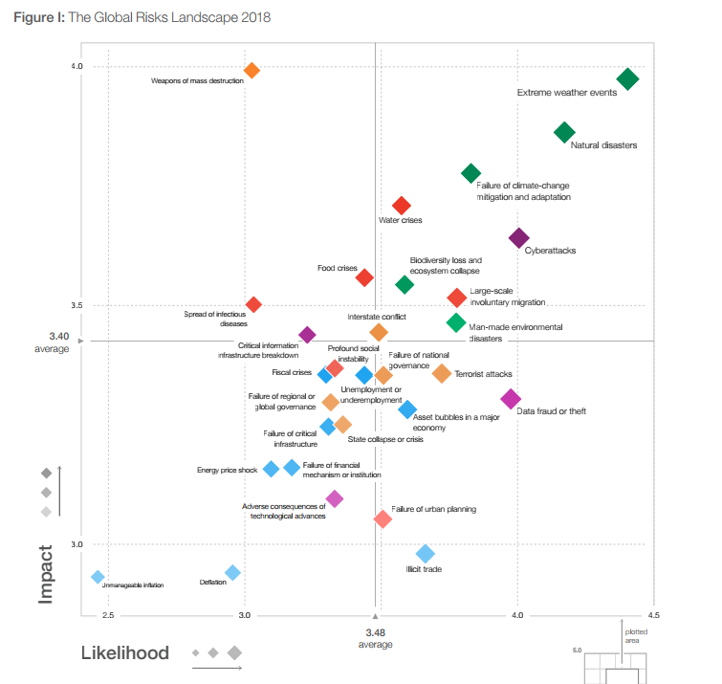

WMO Strategy
The basis of our new Strategy – global risks

Slide 5

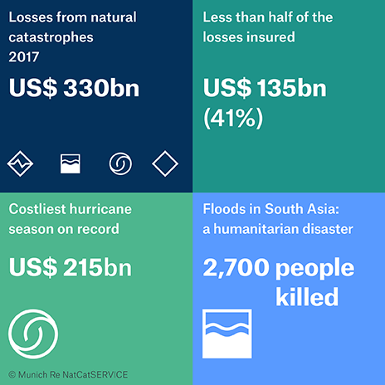
Public-Private Engagement - Drivers
Agenda 2030 for sustainable development
17 Sustainable Development Goals (SDG)
Call for engagement of non-state actors
Paris Agreement
Sendai Framework for Disaster Risk Reduction
There is a need for the public and private sectors and civil society organizations, as well as academia and scientific and research institutions, to work more closely together and to create opportunities for collaboration …”

Slide 6
Public-Private Engagement - Drivers
Rapidly changing technological environment and business landscape
New opportunities for optimization and efficiency through integration of networks, computing power and service delivery
Pressure from governments on public budgets
Risk on sustainability of national, regional and global infrastructure
Persisting information and service gaps in developing countries, LDCs and SIDS

Slide 7
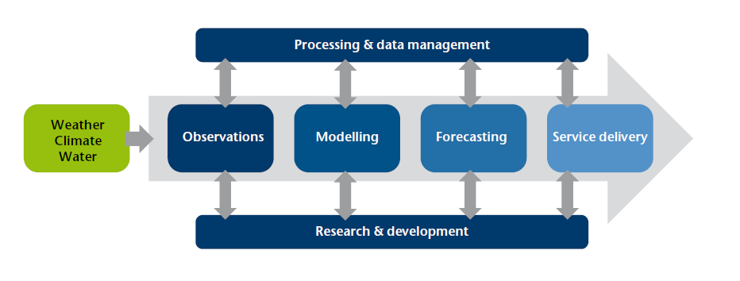
PPE in the “service value chain”
Before: Private sector was engaged mostly in the equipment manufacturing and tailor-made service delivery to business customers
Now: Private sector is engaged in the whole value chain

Slide 8
Focus of WMO PPE activities
Update its policies and guidance to assist Member countries;
Enhanced partnerships – World Bank, industry (HMEI, others), Academia;
Align systems – WIGOS, WIS, GFCS – with the GWE realm;
Maintain its role as UN authoritative voice on weather, climate and water.

Slide 9
PPE & GWE – Activities have been growing
2016
2017
2018
2014
2015
InterMET Asia 2017
EC-69 Roadmap on PPE
WB Washington DC
Workshop
Congress-17
WMO Guidance on partnership with the private sector
EC-68
Special
Public-Private
dialogue
AMS-2018 GWE session
GWE Forum
InterMET Asia 2018
EC-70 PPE Policy Framework
EMS-2018
Met Tech Expo 2018
GWE Conference
Studies, publications
WWOSC
Future of Weather Enterprise Panel

Slide 10
Outcomes of EC-70
The Executive Council supported the PPE and GWE orientation;
Adoption of the WMO PPE Policy Framework – set of principles for successful PPE;
(available here from 11 Sep 2018)
Better integration of partners, including private sector and academia, in the WMO process;
Directions given for high level policy act on PPE and GWE by Congress 18 (June 2019).

Slide 11
Principles of successful PPE
Seek for “win-win” PPE scenarios that benefit society;
Recognize mandates and responsibilities stemming from international and national legislation and regulations;
Ensure a “level playing field”, cost- and benefit-sharing;
Engage in partnerships on matters critical to societies where joint action would bring efficiency and better service;
Promote WMO international norms and standards in meteorology, hydrology and climatology and their uniform implementation;
Accelerate uptake of research and technological developments into operations and stimulate the generation, translation and dissemination of knowledge;
“No country left behind” principle - keep the needs of developing countries, LDCs and SIDS in focus – combine efforts to bridge existing gaps and develop capacity in using state-of-the-art technology.

Slide 12

GWE/PPE – Challenges
How to keep the public investments for the core data and services;
How to maintain the NMHSs’ role of “authoritative voice” in warnings;
How to be strong and competitive in the “weather market”;
How to retain overall visibility and
authority in weather, water
and climate.

Slide 13
GWE/PPE – opportunities for NMHS
Get more data;
Smart investment – use of modern technology in storing, computing, communication;
Outreach to users – e.g., through social media;
Focus on main mandate – core networks for observations, climate data, protection of life and property;
Be more efficient;
Education and Training.

Slide 14
GWE/PPE – Opportunities for development
Develop a new approach to development assistance focused on sustainability;
Change the assistance model from “selling stuff (equipment)” to “service-oriented partnerships”;
Consider the local capacity for long-term operation and maintenance;
Create incentive for data access and data sharing – both nationally and internationally;
Raise visibility of NMHS and promote its critical role in safety-related services.

Slide 15
Key Messages
Understanding the new realm
New era in weather and climate services;
Global risks, economic and political challenges need to be addressed;
Scientific and technological advances generate rapidly growing market demand and opportunities for services;
Increased need for cooperation among GWE sectors and all members of weather and climate communities.
Notes:
Understanding the new realm – Comprendre ce nouvel espace qui s’est créé.

Slide 16

Thank you
Merci
Gracias
Obrigado
contact: divanov@wmo.int

