Slide 1
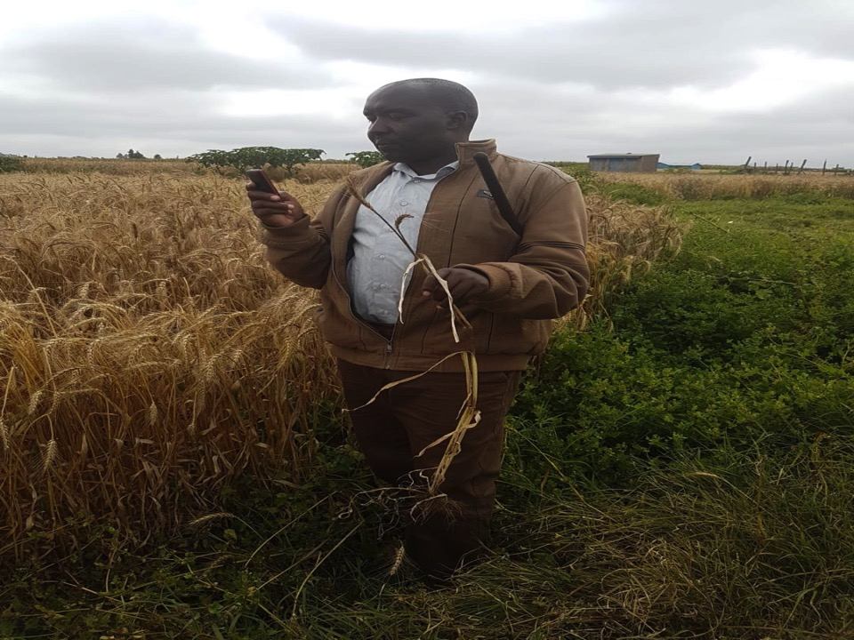




ECCAS HYDROMET FORUM and DRR PLATFORM
The Role of TAHMO in Africa
14 -16 November, 2018. Hotel Boulevard, Libreville, Gabon
Ahmed Balogun & Frank O. Annor
FUTA & TU Delft - KNUST

Slide 2

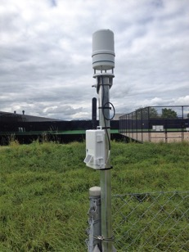
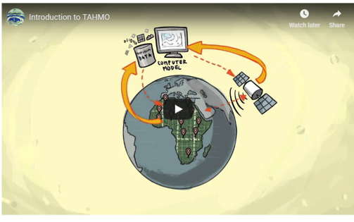
What is TAHMO?
The Trans-African Hydro-Meteorological Observatory (TAHMO) Initiative aims to develop a vast network of weather stations across Africa. Current and historic weather data is important for agricultural, climate monitoring, and many hydro-meteorological applications.
The idea behind this project is to have at least one automatic weather station every 30 km in sub-Saharan Africa. This entails the installation of 20,000 stations across the continent.
This will be achieved by applying innovative sensor technology and ICT, TAHMO stations are both inexpensive and robust. Stations are placed at schools and integrated in educational programs, adding richness to the curriculum and helping foster a new generation of scientists.
Local weather data will be combined with models and satellite observations to obtain insight into the distribution of water and energy stocks and fluxes.

Slide 3

Planning without data is like a ship without compass …. Devika, G.D. Goenka public school, New Delhi.

Slide 4
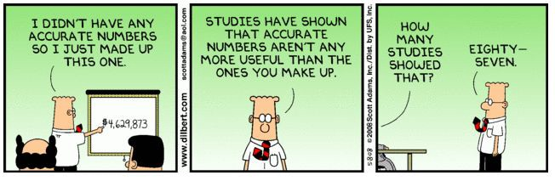
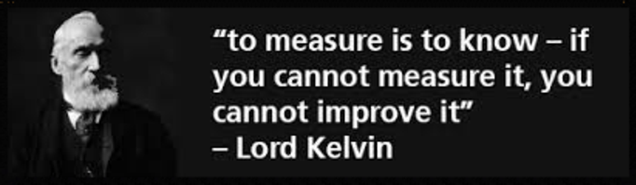
Notes:
Outline: Two parts, intro project and ensemble behavior

Slide 5
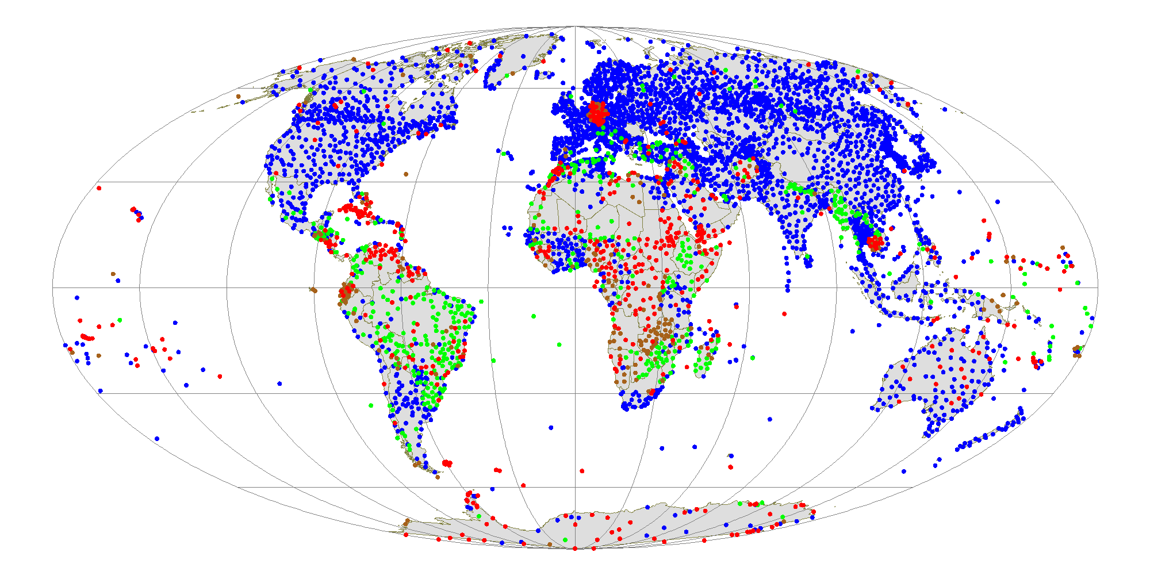

Importance of reliable weather data
Notes:
Imagine life without weather data. Personnaly I look at the weather every day in order to know if I am going to take an umbrella or rather my sunglasses! Well that is clearly not essential to life but does increase my confort as I do not need to carry everything around.
This is clearly not the case for everyone. Many people rely on good weather forecast for their work, for their life etc. I.e we wouldn’t be able to forecast extreme weather events and thus no emergeny response would be impossible. Without reliable weather flood and crop insurance wouldn’t exist etc.
Today, and especially in our latitudes weather data improves our lives imensly. But, there are still parts of the globe where weather monitoring doesn't exist. That is exactly the case across much of the African continent.
This is the reason TAHMO came to exist.

Slide 6

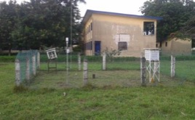
What is broken in African climate observation?
Hydro-Met services have little government support
Many AWS from different projects and providers
Only few stations reporting
No local spare parts shop - material purchases are difficult
Lack of Maintenance (Calibration, replacement of batteries, sim connections etc.)

Slide 7
What is broken in African climate observation?
Digitizing old records is expensive and hard
There is no market for raw data & data from a single country
Lack of structured data storage
Manual quality control
Data use & services not exploited? Agriculture – very little
Forecasts requires high tech, best at global scale

Slide 8

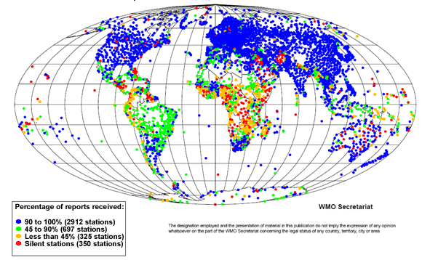
TAHMO’s objective
Value, Shared Responsibilities & Financial Sustainability
Leapfrog: 20,000 TAHMO Stations!
1 station every 30 km

Slide 9
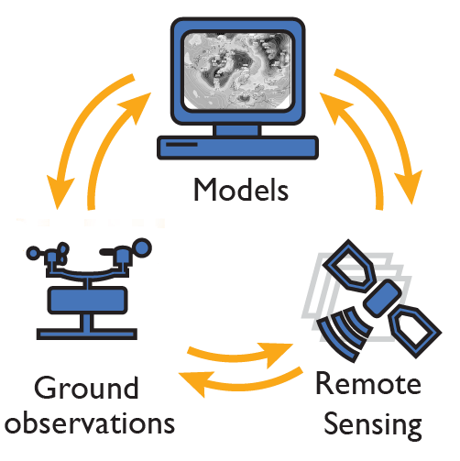
Data assimilation: Need to integrate ground & Satellite data

Slide 10
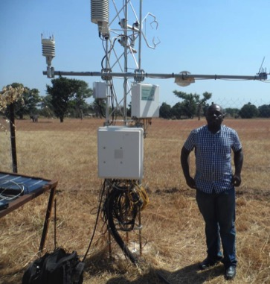
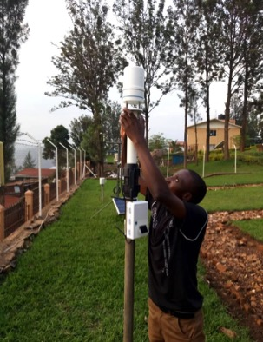
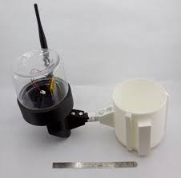
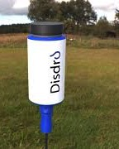


Innovation - AWSs & Disdro + Other Sensors

Slide 11
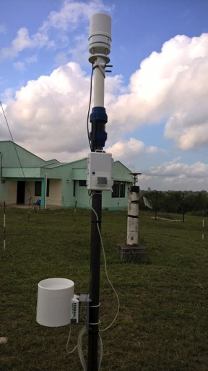
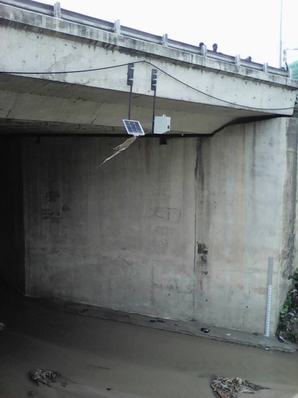
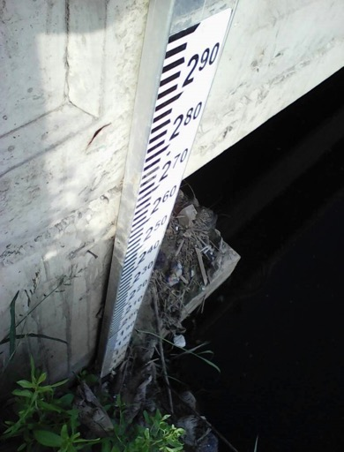
AWS and AWL Stations
Radar Stage Sensor installed at Ubungo, Dar es Salaam
Staff Gauge installed at Jangwani, Dar es Salaam
TAHMO Gen 3 station installed at Ardhi University, Dar es Salaam
Stations installed by TAHMO

Slide 12
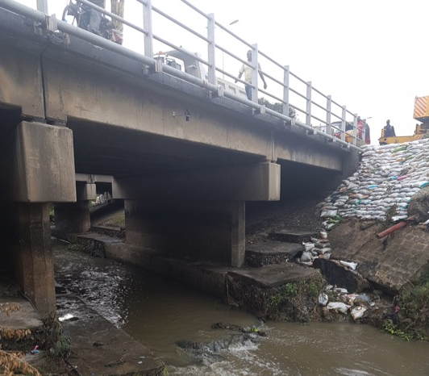
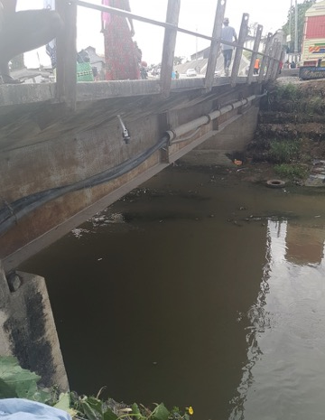
Non-contact Measurements
Ultrasonic Water Level Station Kigogo Misho
Dar es Salaam
Ultrasonic Water Level Station Kigogo Sambusa, Dar es Salaam
Stations installed by TAHMO

Slide 13
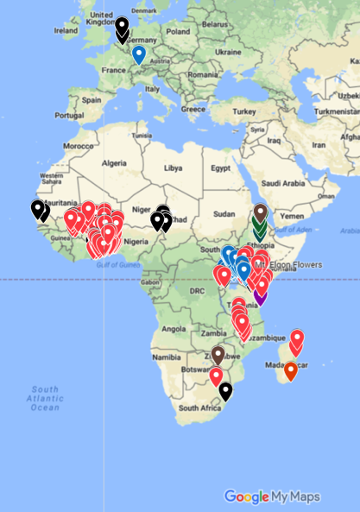
Current TAHMO stations/countries
Countries with offices
and more than 35 stations
Participating countries
Notes:
We are operational in 21 countries in which 3 of them have over 35 stations (Kenya, Uganda and Ghana). In Kenya and Ghana we also have spinofs of TAHMO in the form of local NGO’s.
We are rapidly expanding and will be having over 500 stations installed by the end of this calendar year.

Slide 14





Innovation should be in context
Africa is heavily (70%) an agrarian economy so TAHMO’s goal to improve agriculture productivity
School2School program :
promotes climate change education in schools by co-developing curriculum for schools to help them understand and adapt better to climate change – thereby making them climate resilient
Climate and weather data availability:
TAHMO promotes awareness about changes in climate and helps access how effective adaptation and mitigation measures
https://sustainabledevelopment.un.org

Slide 15
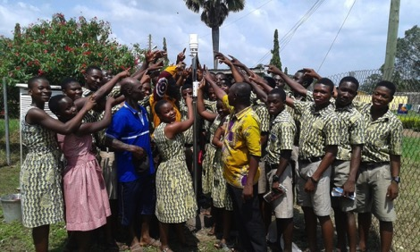

School 2 School Program
>90% of stations installed in Schools
These data bring up all sorts of great science and math learning opportunities:
Energy
Speed
Humidity
Geography
Patterns versus random
https://school2school.net
Long term association with schools
Contextual Science education package
Emphasize global equality – same lessons in USA and Africa
Connect across cultures
Notes:
Most of these stations are installed in schools (primary and secondary). One of parallel projects, part of TAHMO, is the School 2 School program.
The idea is to install stations in African schools and provide educational curriculums which teachers can use in their class.
In parallel we try to set each african school up with a partner school in the US and Europe
To foster climate education worldwide; by connecting one school to ‘sister schools’
Weather data enables great science and math learning opportunities: Energy, Speed, Humidity, Geography, Patterns versus random

Slide 16
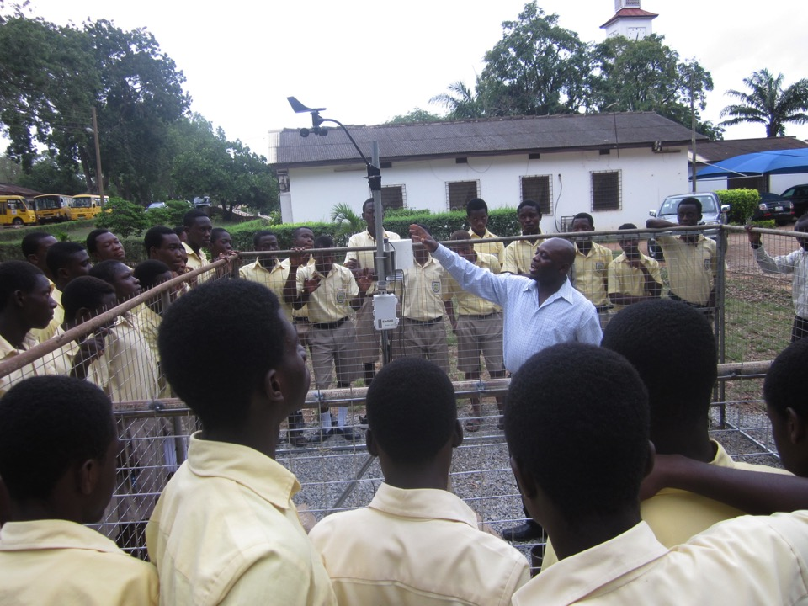

Slide 17
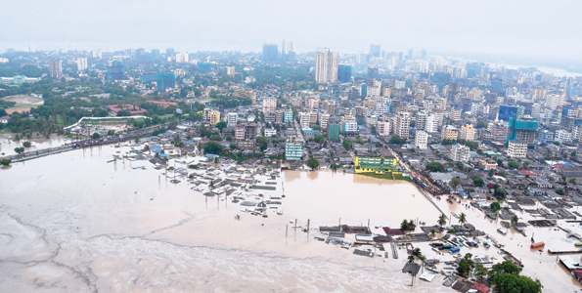

TAHMO Program - Dar es Salaam
Tanzania Urban Resilience Program
Early Warning Msimbazi
Notes:
Outline: Two parts, intro project and ensemble behavior

Slide 18
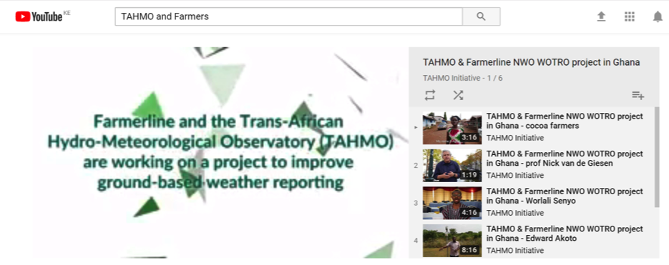
TAHMO Program - Ghana

Slide 19
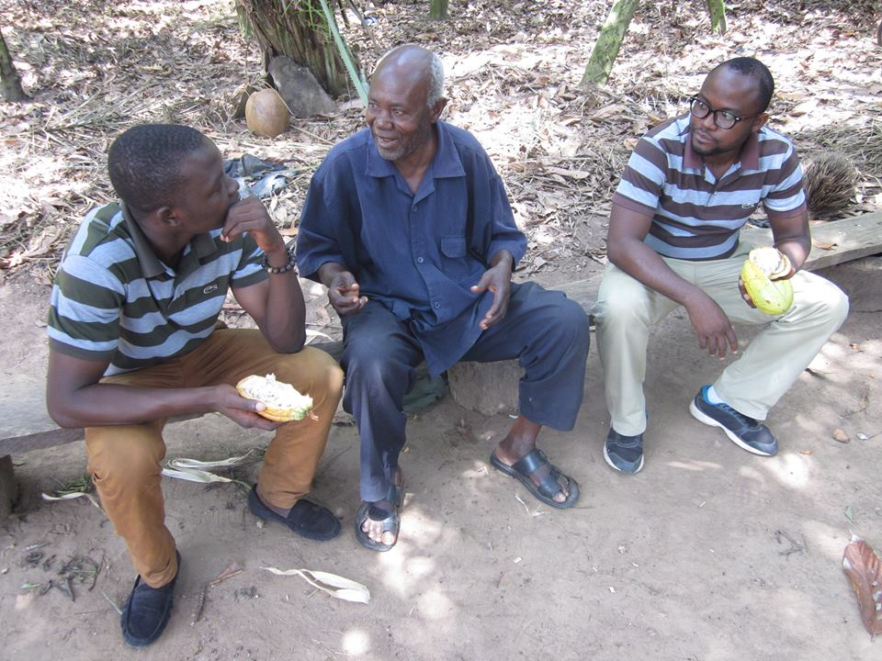
End-users: Cocoa farmers such as George benefit at the end!

Slide 20
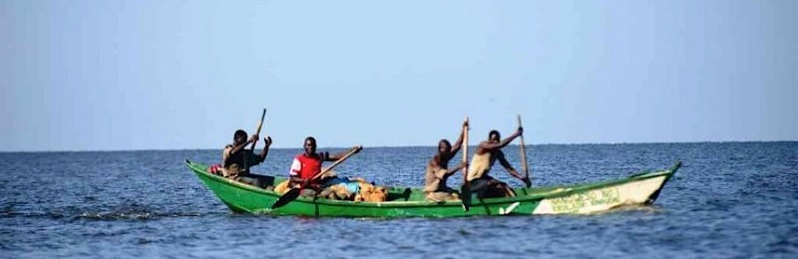
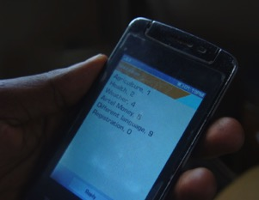
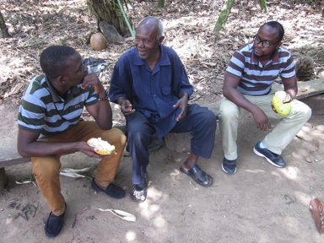
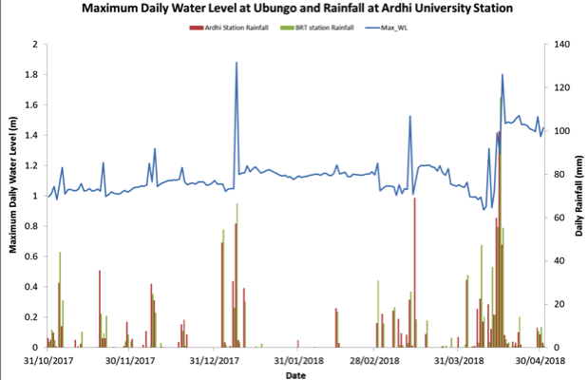
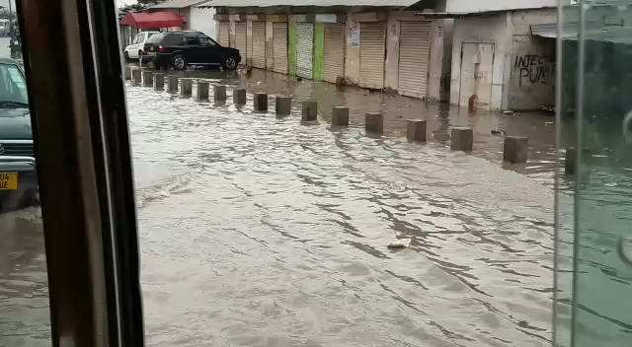
Delivery of Products & Services
© http://theagribusinessmagazine.com
161
Footage
by Tanzania Red Cross Society

Slide 21
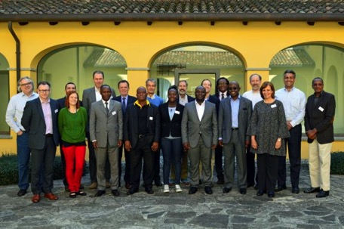
Public Private Partnerships – PPP’s
PPP’s to improve Climate Observation
Partners:
Weather Underground
IBM
NMA
WMO
NMHSs
Etc.
Report can be found on http://tahmo.org
We can work together!
A pilot with IBM and Kenya Met Department for Agriculture in Kenya:
On-going!

Slide 22
But how does the reality look like?
MoU with NMHS
TAHMO AWS network
Data Provisions NMHS and TAHMO
QA/QC + Weather Forecast
Products & Services
This is currently the case in 21 countries
Still working on this !!
Our main current funding comes from research projects and collaborations with the private sector (i.e. IBM/Weather Company)
Acronyms
NMHS : National Hydro-Meteorological Agency
AWS : Automatic Weather Station
MoU : Memorandum of Understanding

Slide 23





Market analysis & User needs
Market Segments & Users
Smallholder farmers
Hydropower companies
Input providers
Drinking Water Companies
Solar / Photovoltaic
Large farmers
Wind farms
AGRICULTURAL PRODUCERS
Water Management Authorities
ENERGY
PROVIDERS
Farmer’s organizations
Extension Officers
Commodity buyers
WATER MANAGERS
Water producing companies
Government agencies
Crop insurance
Water Companies
Insurance companies
Aquaculture insurance
Livestock insurance
AGRICULTURE INSURANCE COMPANIES
DISASTER AND NATURAL HAZARD MANAGERS
International agencies
Civil society and citizens

Slide 24

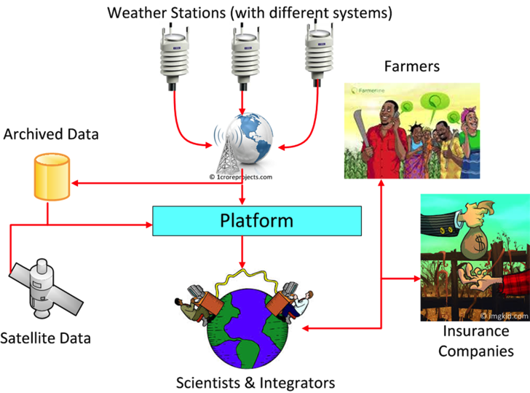




Value Chain Approach needed in all Applications
credit
Markets
Decision Support Products & Services
Risk Management
Decision Support Products & Services

Slide 25

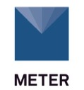
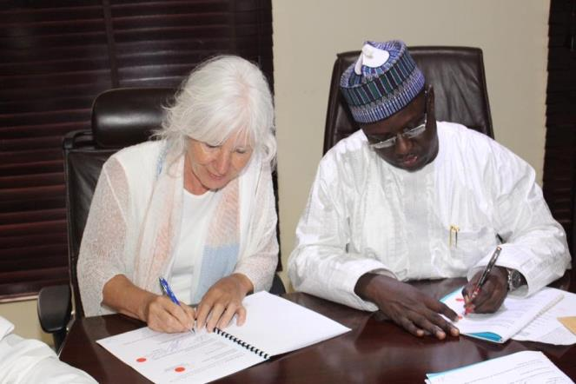








Join the TAHMO initiative
Signing of MoU with NiMet (Nigeria)
www.tahmo.org
www.school2school.net
Email: info@tahmo.org
KNUST

Slide 26
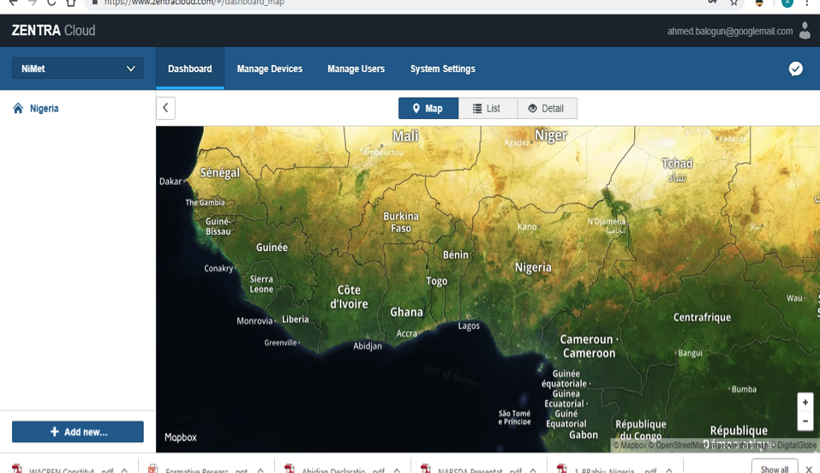

Slide 27
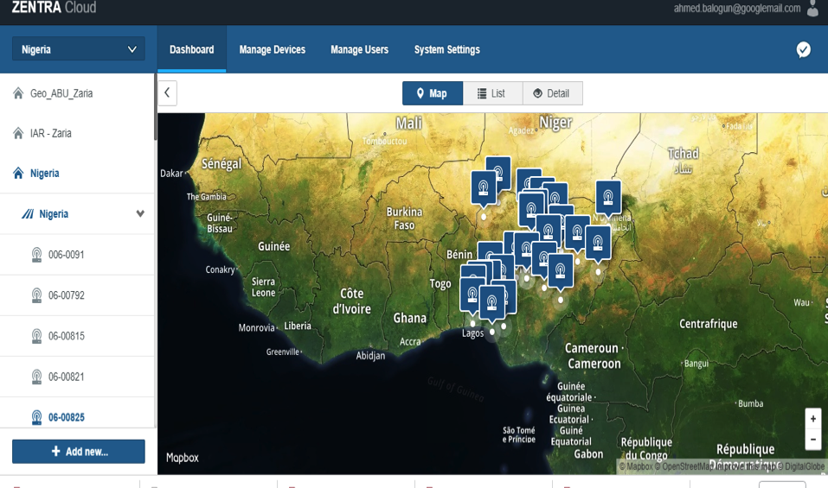

Slide 28
Thank you for your attention!
Merci Beaucoup!

